Slide 1



Performance Testing Dashboard

Slide 2




Project team
Dang Thi Thao My
Le Huynh Anh Tuan
Bui Nguyen Thien Khanh
Nguyen Anh Quan
15905067
1325907
15907679
15905072
Supervised by MSc. Truong Phuoc Loc

Slide 3
Agenda
What are our goals?
What is the solution?
How do we do this?
What are challenges?
What have we achieved?
Demo

Slide 4
What are our goals?

Slide 5




Project Overview
Performance Testing Service
Validation Team

Slide 6
Drawback of Jmeter
Set up Jmeter
Configure Master – Slave System
Manage Scripts & Reports
Notes:
The testers of the team have to set up Jmeter on their own PCs and configure a master-slave system whenever they need to performance test in the distributed mode. Moreover, they have to manage test scripts and extract test result information into report files manually before sending it to their customers. The testing management becomes a time consuming process.

Slide 7

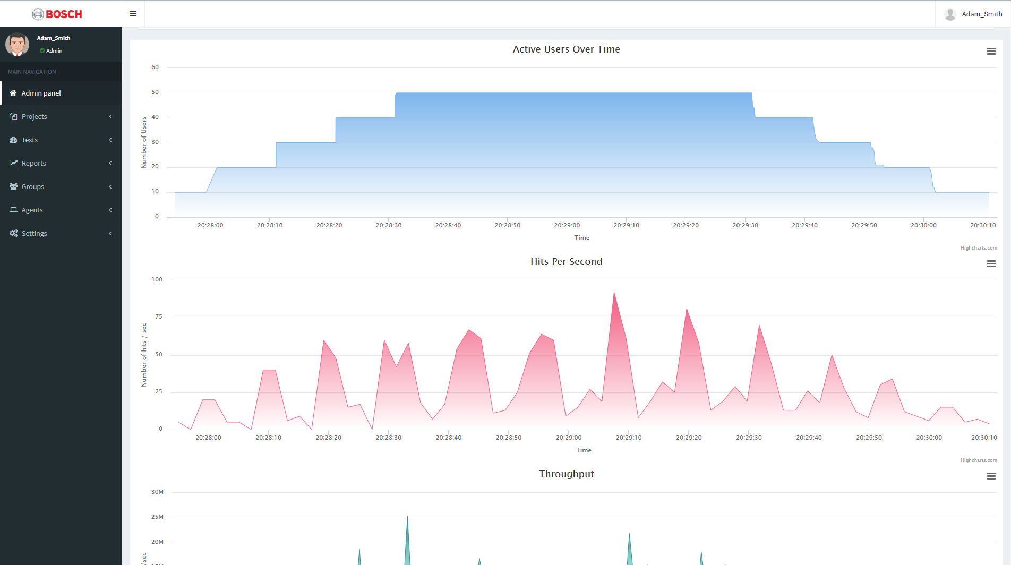
Project Description
Run Performance Test
Provide Real-time Report
Analyze test script and execute Jmeter
Analyse test results immediately while test is executing and show in the dashboard
Manage Test Scripts
Reports Manage & Analysis
Upload , store , and manage the the test scripts
Analyse test results
Generate report after test execution
Track history of the reports
Control Distributed System
Manage Users
Authenticate Users to access pages
Authorize Users
Connect Agents to the platform
Control Agents to run test

Slide 8
What is the solution?

Slide 9








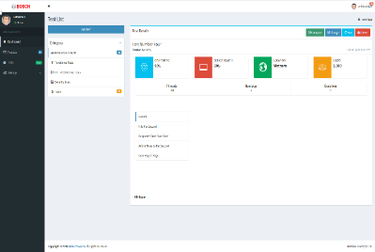













Solution Architecture
+200 VU
Agent
+200 VU
Dashboard Server
Dashboard
+200 VU
Agent
Upload Script
Agent
Distributed System
Target Service

Slide 10









Layered structure
Controller
REST Controller
Presentation
Templates
Views
Resources
Business
Engine
Service interfaces
Project
User
Test Case
Agent
Boot
Security
Configuration
Report Analysis
Data
Web MVC
Models
Persistence
Repositories
Entities

Slide 11







Technology

Slide 12
Benefits
Centralize Testing
Reduce Cost
Increase Efficiency

Slide 13
How do we do this?

Slide 14
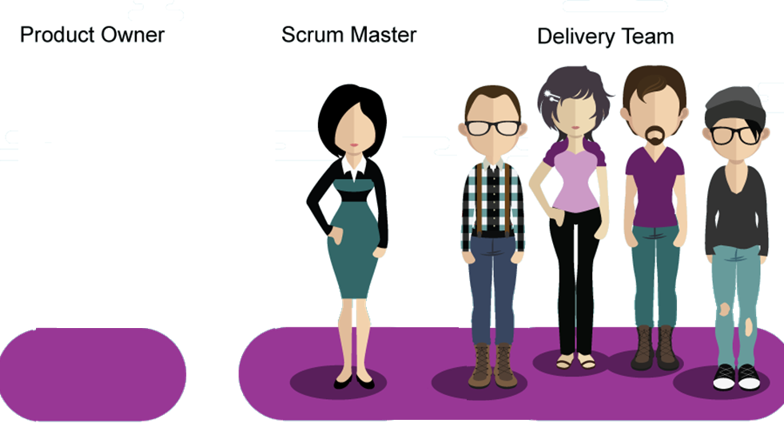

Roles
Khanh Bui
Mr. Man To (Bosch)
My Dang
Tuan Le
Quan Nguyen
Product Owner
Scrum Master
Development Team

Slide 15


Timeline
Development
Sprint 4-14
Preparation
Sprint 1-3
Testing & Maintenance
Sprint 15-16
Plan
Knowledge Acquisition
Solution Design
Testing
Go Live
Review
Analyze
Implement
Design

Slide 16
Milestones
Minimum Viable Product
Final Product
Go Live
Distributed
Release 2
Report
Release 1
Optimization
Test
User
Script
Project
Prototype
May
December
January
March
Notes:
Release details 1 2 3

Slide 17





Processes
Planning
Daily
Review
Retrospective
Requirements Development
Post Delivery
Bug-fix
Reviews
Verification
Validation
Requirements Management
Testing
Re-test
Test Plan
Test Cases
Issues Log
Design
Integration
Sprint Review and Retrospective
Coding
Peer Review
Quality Assurance Process
Track Changes
Notes:
The documentation phases is strictly followed. We record any changes or issues we found in our documentations to keep the information updated or use as evidence.
For the process of making product: We review our backlogs requirement have meet the user acceptance that our team have define. We find the solutions improve our performance in retrospective meetings.
Sprint Review we will check the acceptance criteria of the requirements are met. Retrospective : We find a solutions , look back at our self for better performance.
During planning we proposed our approach on testing using Retest and Peer Review
To identify bugs we input test plan , test cases and issue log to prepare for test executions. We enhance our codes or find bug during peer review. We will re-test the identified bugs on the post delivery bug-fix.
http://istqbexamcertification.com/difference-between-regression-testing-and-retesting/

Slide 18
QA Outcomes
Notes:
After test executions, we will evaluate the test report. Right now, we have 101 test cases for test executions, we have run 6 test releases and the number of defects left on the product is 3. So after the evaluation of the tests and issues logs based on the result.

Slide 19
What are challenges?

Slide 20



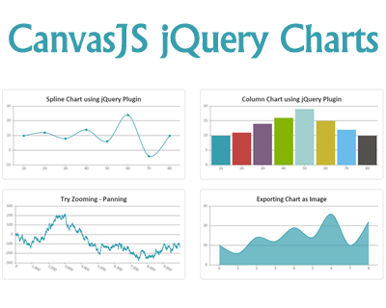





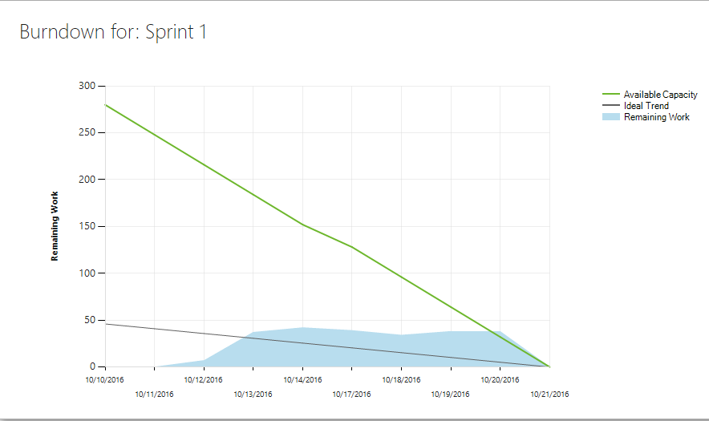
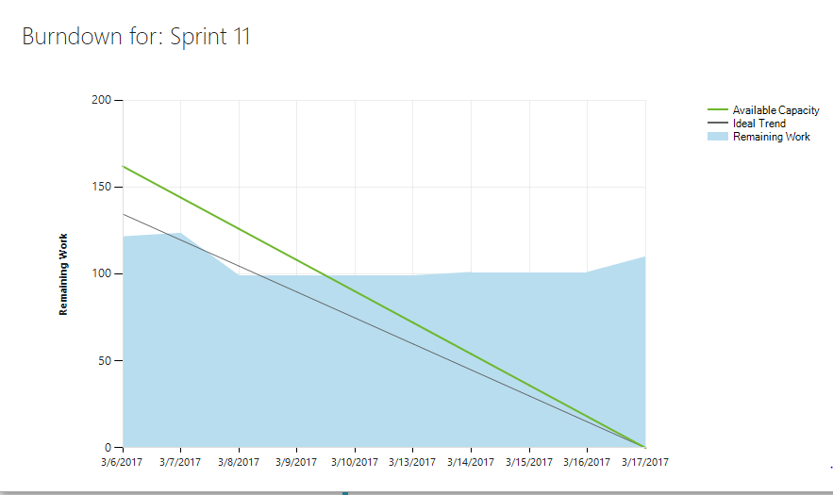
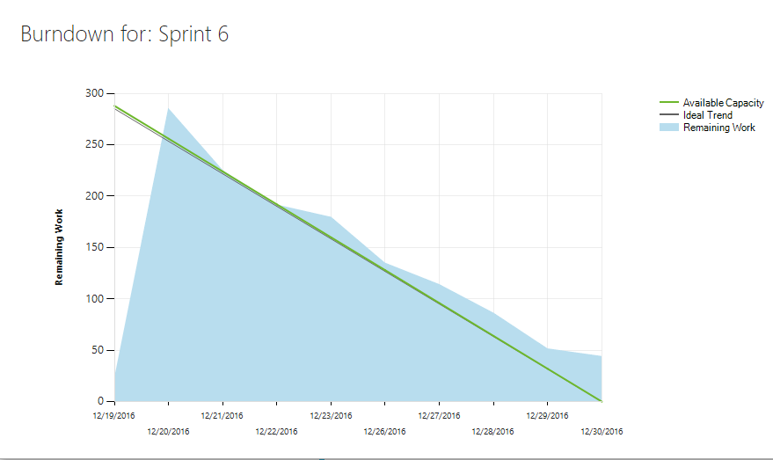


Challenges
Need time for Research the Solutions
Change Graph Technology
Underestimated/Overestimated Effort
Notes:
So in this slide we have 3 main challenge.
The first we cannot estimated correctly the effort and time we need to complete tasks. As you can see on the burn down chart, sometime we input a little effort on that that sprint and use time inefficiently. We sometime do the opposite, put too much tasks and cannot finish it on time. In the future, we should distributed and estimated our task correctly for best performance.
When we implementing report module, CanvasJS does not support the requirement that we need so we use a bigger guy, Highcharts, which have bigger community support.
We don’t have the solution for distributed testing and report analysis after the second release and spent a large a mount of time to find solution.

Slide 21








Opportunities
Interactions
On-board Trainings
Environment
Notes:
From these challenges we realize the opportunities when we are working on this project.
First is that we can interact more with clients and end-users, the validation teams, the software testers. We can ask them if we have any confusion about requirements or knowledge.
Secondly, we were given chance to join the on-boarding trainings for awareness and personal improvements.
Finally, we work in a professional environment where we need to speak English , embrace diversity, collaborate tightly with colleagues and clients, importantly, experience/working with cutting edge IT system process of the company.

Slide 22
What have we achieved?

Slide 23



















Objectives
Achievements
All objectives proposed have met.
Knowledge and Experience
Theories to practices.
Technologies
Frameworks and Tools.
Competency
Sovle Problem
Research
Coding
Presentation
Comunicate
Soft skills and technical skills

Slide 24
It’s time for Demo

Slide 25
Q & A
WHAT
WHY
WHERE
WHEN
WHO
HOW

Slide 26
THANK YOU FOR WATCHING!

